Slide 1

Visualization and Analysis –
Tutorial Presentation for Feedback
Date: 11/22/2025
Group Id: A 136 Name of Student Presenting: Aroosha Rasheed

Slide 2
We are using the dataset student_depression_dataset to answer our Research Question
“Is there a difference in the median student academic score (Cumulative Grade Point Average (CGPA)) between depressed and non-depressed University students in India?”

Slide 3
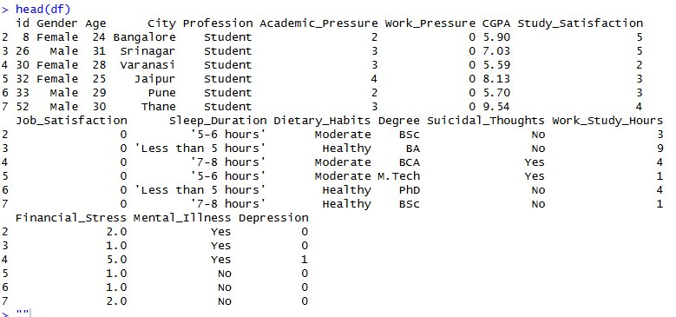
Original Columns
Columns chosen for the visualization:
Academic Score (CGPA) - Dependent Variable​
Depression – Independent Variable​
​
2. Total Rows: 27,901 and 18 columns​
​
​
​

Slide 4
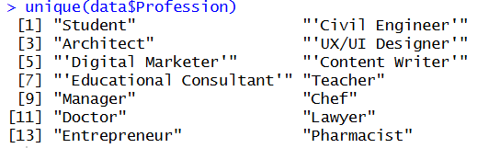

Data Filtering and Cleaning
Filter Profession == “Student”
#find the unique values in "Profession" columnunique(data$Profession)
​
​
​
> #find the number of rows that are not students
> data %>%
+ filter(Profession != "Student") %>%
+ nrow()
31
# Filter students only
data_students <- data %>% filter(Profession == "Student")

Slide 5
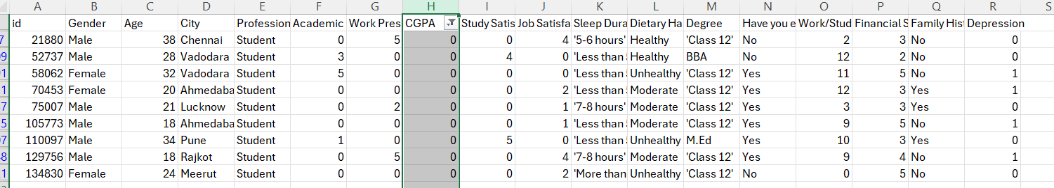

Data Filtering and Cleaning
2. Remove any rows with N/A values/null values from CGPA / Depression columns and remove rows where “CGPA” = 0
​
​
​
> data_students %>%
+ filter(CGPA == 0) %>%
+ nrow()
9
# Clean data; Remove any rows with missing CGPA or Depression values, and remove CGPA of 0 data_clean <- data_students %>% filter(!is.na(CGPA) & !is.na(Depression) & CGPA != 0)

Slide 6
Part 1: VISUALISATION

Slide 7
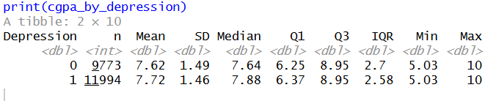
Difference in mean/median CGPA for depressed/non-depressed students in India

Slide 8
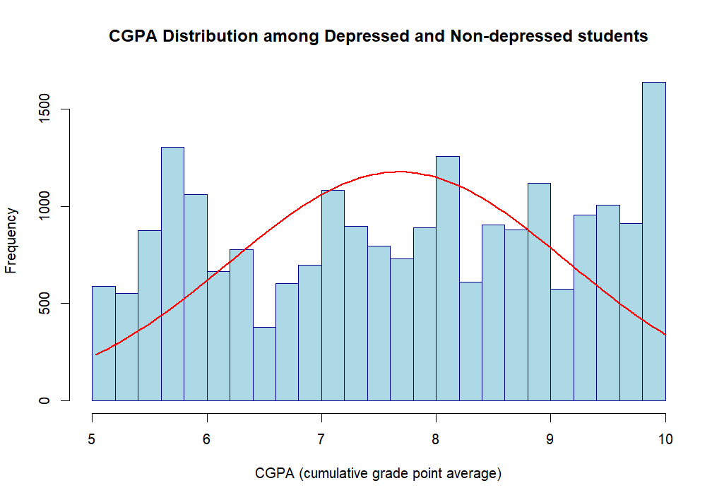
Here is a Histogram showing the frequencies of our dependent variable to include the normal curve overlay (shown in blue).
Our RQ asks about Differences in means/ medians
Histogram - Overall CGPA
The normal curve overlay does not follow the shape of the underlying data, so we use the non-parametric test that does not assume normality: Wilcoxon also known as the Mann Whitney U Test.
8

Slide 9
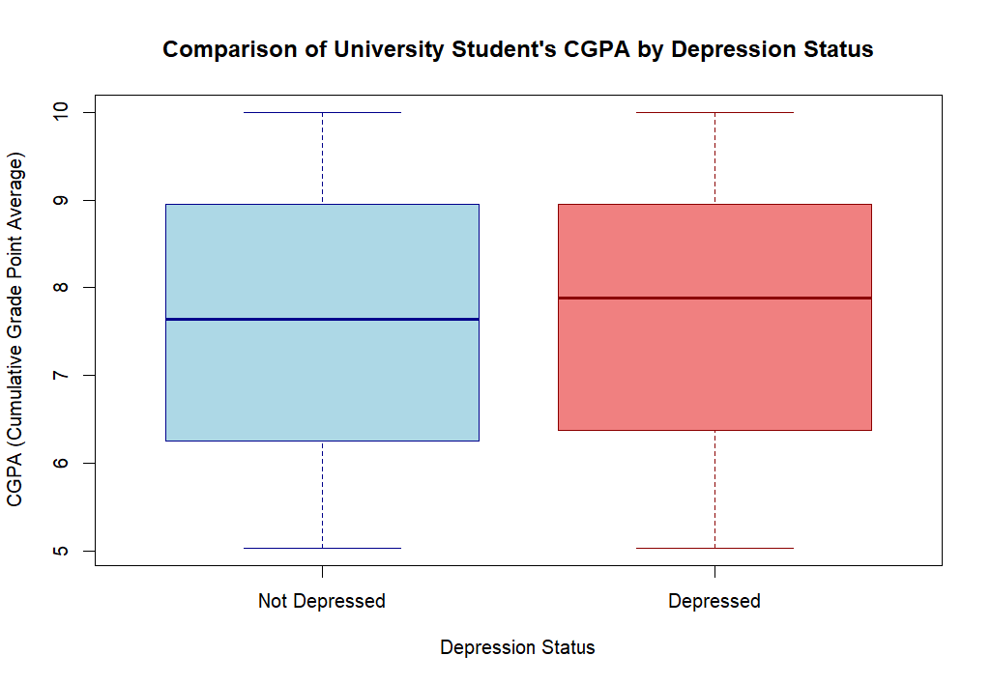
2. Boxplot
Outliers have been removed for two records
where CGPA = 0 for not depressed students

Slide 10
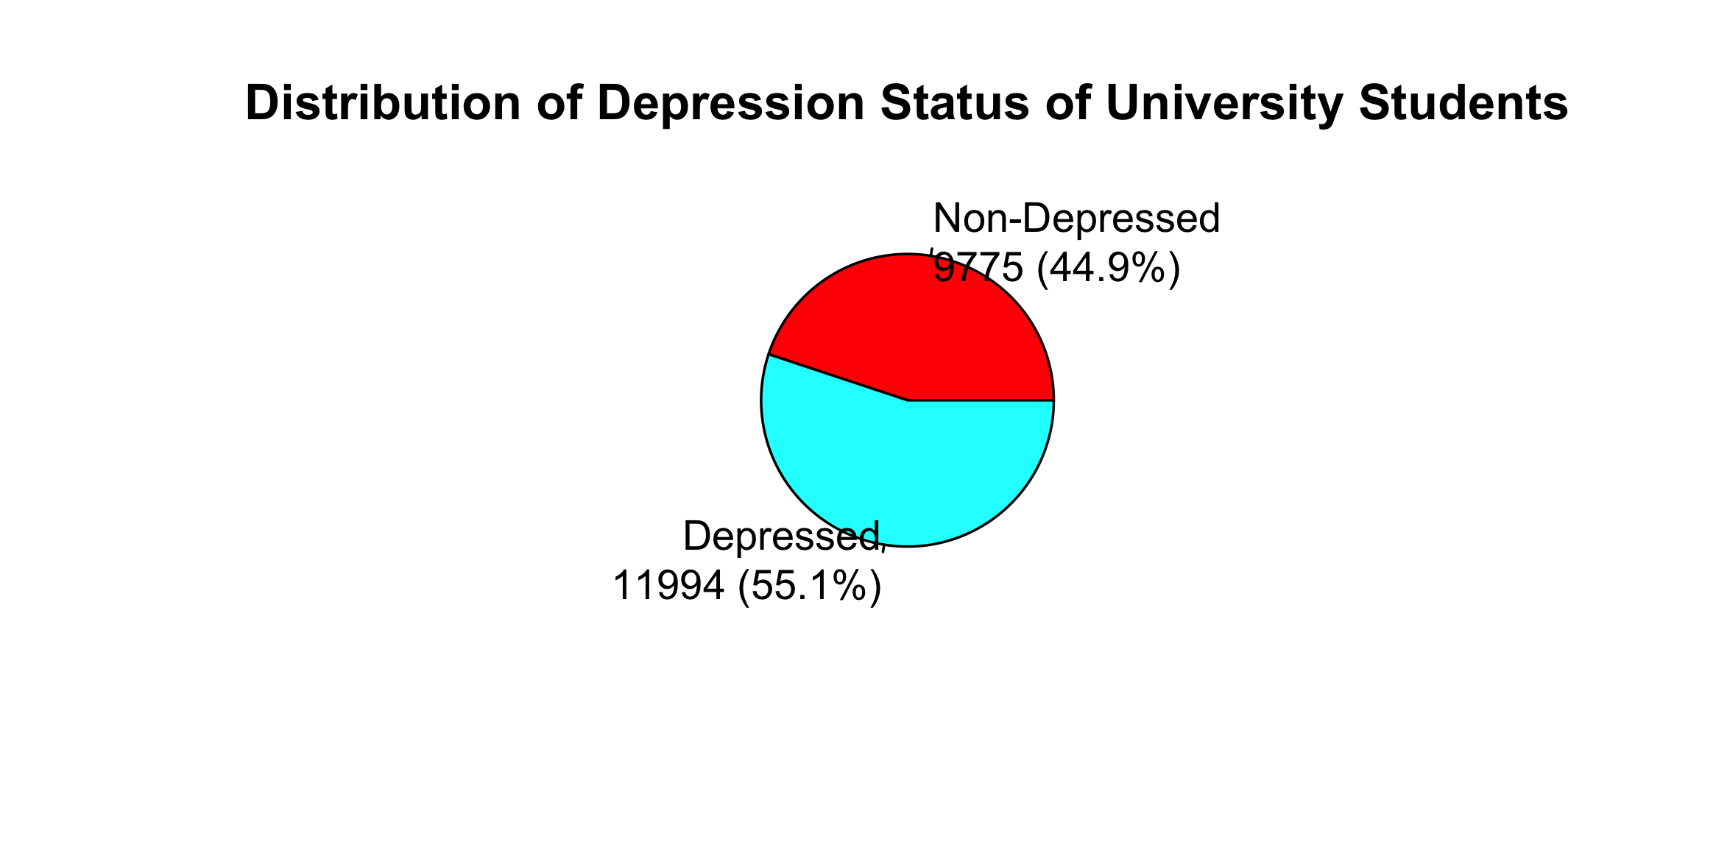
Here is a Histogram showing the frequencies of our dependent variable to include the normal curve overlay (shown in blue).
Our RQ asks about Differences in means/ medians
Piechart of Depressed and Non-depressed students
10

Slide 11
Part 2: Analysis

Slide 12
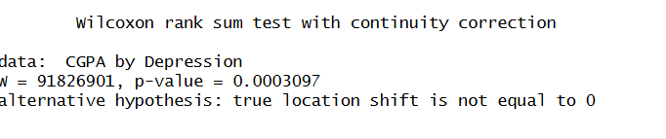
R Script and Results (independent T test) – The Analysis
PRE 7COM1079-2022 Student Group No: ?????
12
# Statistical Tests
# Wilcoxon Rank-Sum Testprint("Wilcoxon Rank-Sum Test:")
wilcox_test_result <- wilcox.test(CGPA ~ Depression, data = data_clean)print(wilcox_test_result)
Notes:
12

Slide 13
R Script and Results (Wilcoxon) – The Analysis
PRE 7COM1079-2022 Student Group No: ?????
13
p-value = 0.0003097 < 0.05 (The result is significant)
Null hypothesis (H0): There is no difference in the median student academic score (Cumulative Grade Point Average(CGPA)) among depressed and non-depressed University students in India. ​
​
Alt hypothesis (H1): There is a difference in the median student academic score (Cumulative Grade Point Average(CGPA)) among depressed and non-depressed University students in India. ​
Reject the null hypothesis. There is a different in the median academic score(CGPA) between depressed and non-depressed University students in India.
Depressed students in India perform better academically in terms of their Cumulative Grade Point Average (CGPA) compared to non-depressed students.
Notes:
13

